Slide 1
Introduction To Information Technology

Slide 2
Defining Information
What is Information?
Information is any knowledge that comes to our attention. That could be voice, image, text and video
What is data?
Data is information when dealing with the machine

Slide 3
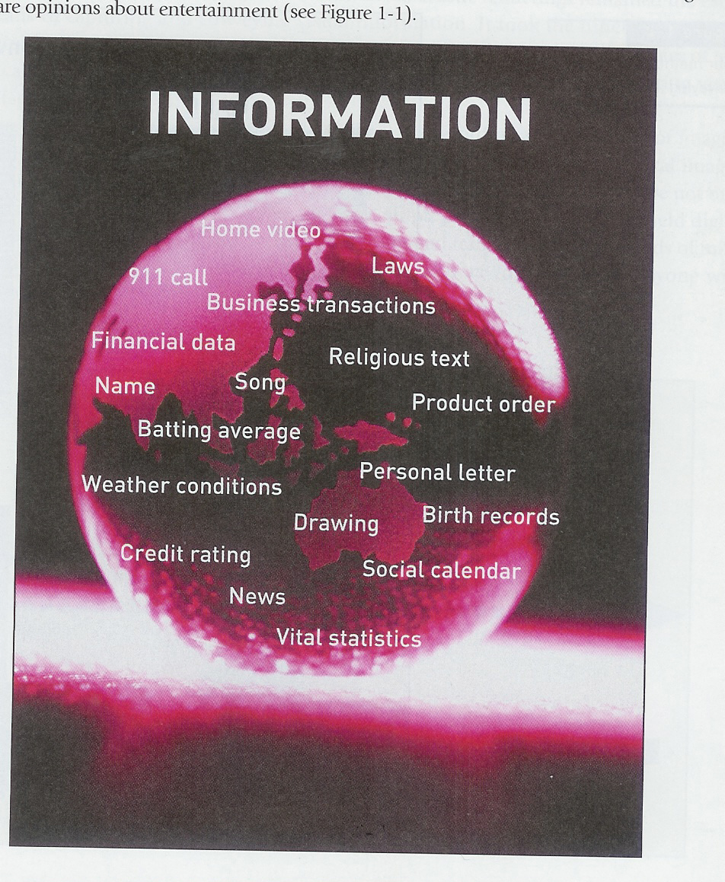
What Counts as information

Slide 4
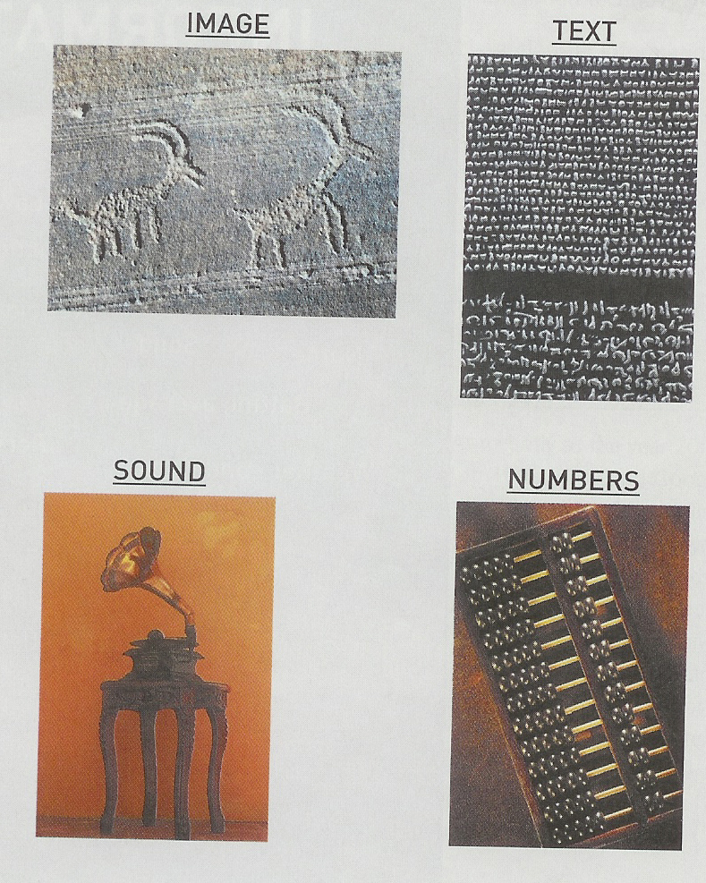
Methods for conveying information

Slide 5
Defining Information Technology
Information Technologies are systems of hardware and/or software that capture, process, exchange, store and/or present information using electrical, magnetic and/or electromagnetic energy.

Slide 6
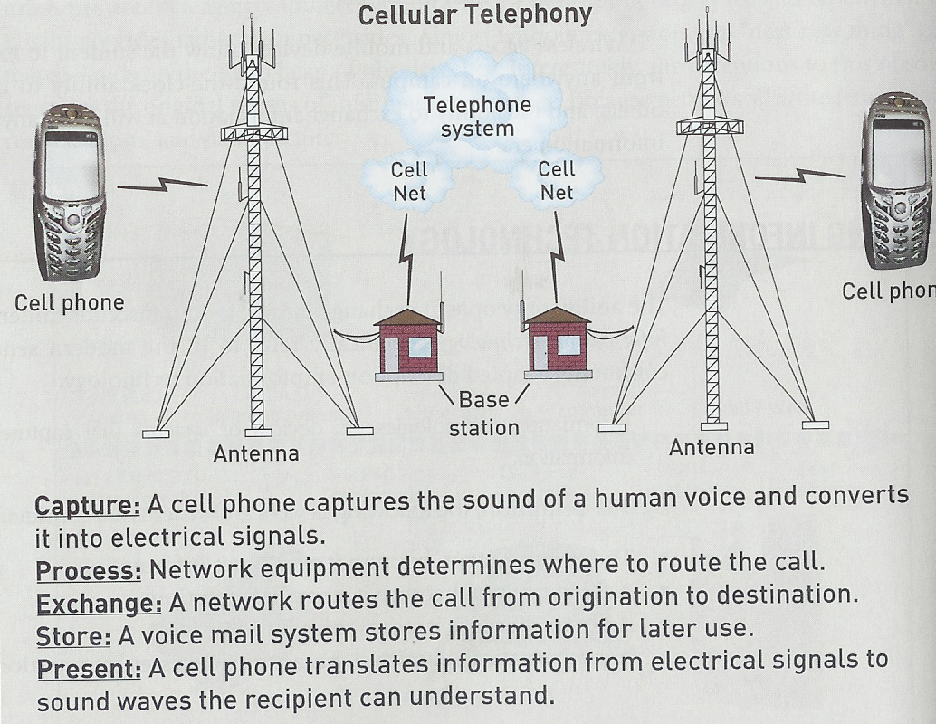
IT Example: Cellular Telephony

Slide 7
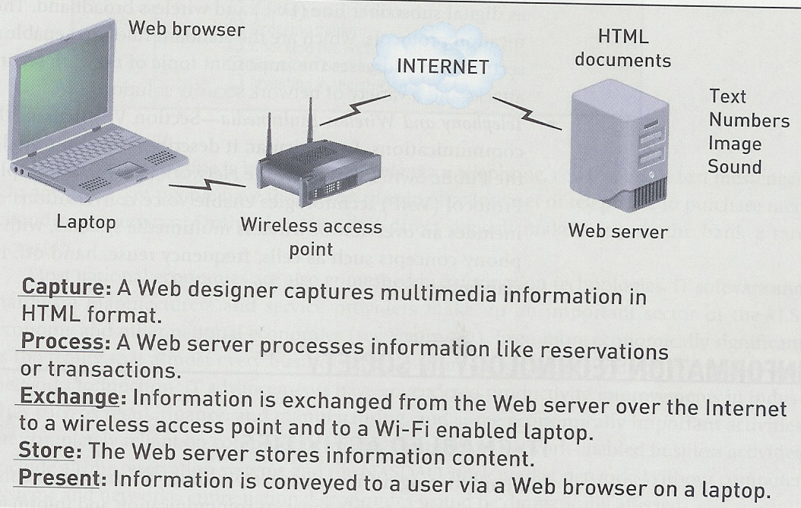
IT Example: Wireless Internet

Slide 8
IT in Society (people)
Personal Communication
  Conversations (phone, cell)
  Messaging (E-mail, SMS)
  Video Coms
Entertainment
  Web surfing
  Downloading video and audio files
  Interactive gaming
Day-to-Day living
  Buying airline tecket
  Ordering books
  Electronic banking/ stock market

Slide 9
IT in Society (business)
Internal Communication
  Computer network
  Corporate website
  Video teleconferencing
  Messaging (SMS, email)
Electronic Commerce
  Call Centres
  Electronic transactions
  Online sales
Business operations
  Factory operation systems
  Databases

Slide 10
Examples on IT Careers
Information Security Jobs
  Address information security
IT Analyst
  Translate business requirement into technical specification
Network Administration
  Configure and operate computer network
Management Consulting
  Provide consulting for government and organizations
Database Administration
  Managing corporate database
Computer Forensics Expert
  Extracts computer evidence for detecting/preventing /prosecuting crimes
IT Sales:
  people on frontline to sell products
Software development:
  develop software solutions

